Slide 1
Student Name
Institution
Course
Title
Date

Slide 2
Timely Documentation of Nurses Notes
Notes:
Welcome!

Slide 3
Introduction
Documentation is the client’s medical record is very important aspect of nursing.
The documentation must be comprehensive, accurate and flexible.
The information in the records of the client should always provide an account of the level of quality that was delivered to the client, (Tuti et al, 2016).
Effective and quality documentation ensures continuity of care, prevent duplication, saves time or error during taking care of the patient.
Notes:
This is the introduction slide of our presentation. According to this slide, documentation is a paramount aspects of nursing care that is used to determine the quality of services that the institution offers to its customers. In order to make sure the documentation is up to the standards, the healthcare organization or institution must ensure that the documentation is accurate, comprehensive and flexible. Having talked of accuracy, flexibility and comprehensively, there are three ways in which this can be ensured. This presentation is going to tackle the three key points in which nursing care or practice can instill in order to ensure that the documentation is accurate, flexible and comprehensive. Come along with me!

Slide 4
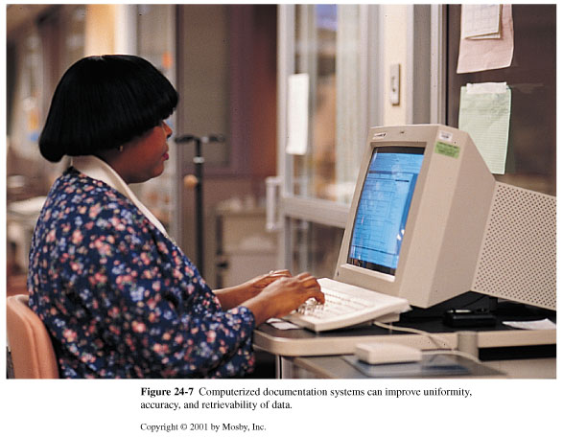
Use of Notes in management of Patient’s Health
Notes:
This slide indicates that use of Nurses’ notes can be used. The picture shows the computerized documentation that is used to improve uniformity, retrievability and accuracy of the data. Through computerization, the Patient’s health can be easily managed. As per the introduction part of the presentation, documentation must be accurate, flexible and comprehensive. Use of digital technology allows the three values to be aspects to be adhered to, (Stevens, 2017).. Quality documentation reduces the number of errors in nursing care.
Thus, nurses need high quality documentation or recording in order to ensure efficiency, standard, accurate and individualized patient care., (Stewart et al, 2017)

Slide 5
Reflection of Quality of Services offered to the Patient
Good documentation of nurses’ notes ensures that the quality of service offered can be easily retrieved, (Yu et al, 2016).
Going through the notes, one can easily ascertain whether the documentation has the following qualities;
Factual
Completeness
Current
Organized
Notes:
This slide shows how the nurses’ notes can be used to ascertain the quality of services offered to the patient.
The factual element means the records or documents should have objective and descriptive information on what the nurse smalls, sees, hears, and feels; e.g., the client is restless, client diaphoretic, A client BP is 80/50 mmHg, and HR is 102 and regular.
Accuracy means that the information provided is exact. The nurses' notes must include institution accepted abbreviations and symbols.
Completeness accounts for the full information on the kind of care offered. The information within a record entry or a report needs to be complete, containing appropriate and vital information otherwise it’s considered incomplete, (Hoover, 2015)..
Current means that the documentation has all vital principles of documentation. In order to increase accuracy, unnecessary documentation must be avoided.
Organized states that the documentation is in logical order. For example, the organized note should include client’s knowledge deficit, nurses assessment and interventions, and the client’s response.

Slide 6
Consequences of not documenting
Incomplete and poor documentation in patient clinical records can lead to the following consequences;
your organization legal and settlement fees,
result in poor patient care by other healthcare team members, (Ford et al, 2016).
cause you to lose your license,
cause lost revenue/reimbursement,
contribute to inaccurate statistical databases,
Notes:
This slide shows the third key point on nurses’ note documentation. Untimely, poor, substandard health care records can lead to your organization legal and settlement fees, cause you to lose your license, contribute to inaccurate statistical databases, cause lost revenue/reimbursement, and result in poor patient care by other healthcare team members. This affects the general operation of the institution. A good healthcare institution is the one that fully subscribes to the law and orders of the state or nation. There are consequences also for wrongly documenting nurses’ notes. Any damage that may arise as a result of wrong documentation becomes the responsibility of the nurse responsible for the mistake. Thus, this is the reason as to why all the healthcare companies should adapt timely documentation of the nurses’ notes, (Lavin et al, 2015).

Slide 7
Methods of recording and documenting Healthcare Notes
In order to ensure quality and timely nurses’ documentation notes, the following methods can be used:
Narrative documentation
Nursing care plan
Data base
Problem oriented medical record (POMR)
Problem list
Progress notes (This are Major section of POMR)
Notes:
This slide shows the methods that can be used to ensure quality and timely nurses’ documentation notes. Narrative documentation is a traditional method that can be used for recording and documenting the client’s problem. It uses storyline format.
Nursing care plan focuses on unique set of needs and goals. It ensures that the care given to audience is individualized thus ensuring patient centered approach. Is used
Problem Oriented Medical record- emphasizes more on client’s problems. The data is organized in accordance to the problem or diagnosis.
Database-this is use of database. This is use of all available assessment information pertaining to the client such as history &physical assessment, nutrition assessment, nurse’s admission history, ongoing assessment and laboratory reports.
Problem list-the analyzed data is organized in order to make the problem easily identified.
Progress notes-Health care team members monitor and recorded the progress of a client’s problems.
Progress notes.- in this, the health care nurses must monitor and recorded the progress of a client’s problems.

Slide 8
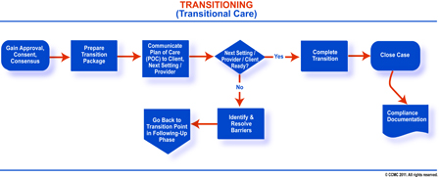
Case Management Plan and Critical Pathways
Notes:
Case Management plan is another method that can be used to improve the nurses’ documentation. The chart above shows the Case management plan that can be used in order to improve quality of timely nurses’ notes. The case management learning structure comprises of what case managers need to know to adequately think about customers and their emotionally supportive networks. It incorporates a nine-stage Case Management Process and seven fundamental learning areas material in any consideration or work on setting and for the different healthcare experts who accept the case manager's role. The flow chart shows how the management is planned from the client’s entry to the institution to the time he leaves the hospital, (Obioma, 2017).
The flowchart is retrieved: https://www.google.com/search?q=Case+management+plan+in+healthcare&source=lnms&tbm=isch&sa=X&ved=0ahUKEwjsr8ea-Z_hAhXj0eAKHU0qCAQQ_AUIDigB&biw=1366&bih=618#imgdii=ywwcGTWTU9CwVM:&imgrc=BUUSbPaQt-lXUM:

Slide 9
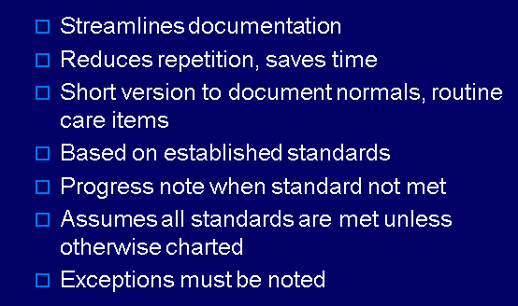
Importance of Case Management Plan
Notes:
Case management plan is important in that; Streamlines documentation, Exceptions must be noted, Based on established standards, Progress note when standard not met, Reduces repetition, saves time, Short version to document normal, routine care items, Assumes all standards are met unless otherwise charted and it ensures that all Exceptions are noted, (UK Essays , November 2018).
Case management isn't a calling unto itself. Or maybe, it is a cross-disciplinary and reliant strength practice.
Case management is a methods for improving customers' health and advancing wellbeing and self-governance through backing, correspondence, education, recognizable proof of administration assets, and help of administration. Case management is guided by the standards of self-rule, usefulness, nonmaleficence, and equity.
Case managers originate from various foundations inside health and human administrations callings including nursing, drug, social work, restoration directing, workers' pay, and mental and behavioral health.

Slide 10
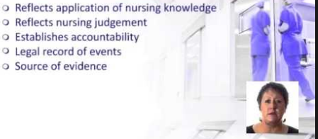
Benefits of Timely Documentation Notes
Notes:
This slide shows the importance of good documentation notes. Through good documentation of the nurses’ notes, one is able to apply the knowledge gained while learning nursing. There is a lot of knowledge that one acquires in school that needs to be applied while. Good documentation also reflects good nursing judgement. Through quality and timing the nurses are able to follow the right protocol learned in school during. Moreover, through timely nurses’ notes, one is able to account for the events that took place during service delivery to the client/patient. Moreover, legal records of events can be traced and easily fixed in order to ensure that the services offered are in accordance to the law. Lastly, nursing notes acts as source of evidence thus making it simple for easy retrieval.
The picture above is retrieved: https://www.google.com/url?sa=i&source=images&cd=&cad=rja&uact=8&ved=2ahUKEwjWlsCm85_hAhUw2eAKHQywB3UQjhx6BAgBEAM&url=https%3A%2F%2Fwww.youtube.com%2Fwatch%3Fv%3Dvh5WvOENPZ4&psig=AOvVaw1UsQiXekBblSVhYw3kTgfL&ust=1553692905134423

Slide 11
Conclusion
in our presentation, we focused on three major points on timely nurses notes:
Nurses’ Notes in management of Patient’s Health.
Reflection of Quality of Services offered to the Patient.
Consequences of not documenting
Notes:
This is a conclusion slide. In our presentation, we have been focusing on three major aspect, the first one is that timely nurses’ notes helps in the management of the patient’s health. These documents are also used in determining the protocol to be used in treating the patient. The second one is that, documented nurse’s notes are also used as proof that the patient was well taken care of. This is in accordance with the hospital's rules and standards and also to the national standards set by the respective healthcare regulatory body. The last one is that, that there are consequences for not following protocol when documenting nurses’ notes. There are consequences also for wrongly documenting nurses’ notes.

Slide 12
References_1
Ford, S., Ford, M., Mitchell, G., & Stephenson, J. (2015). The importance of good record-keeping for nurses.
Obioma, C. (2017). Improving the Quality of Nursing Documentation in Home Health Care Setting.
Tuti, T., Bitok, M., Malla, L., Paton, C., Muinga, N., Gathara, D., ... & Julius, T. (2016). Improving documentation of clinical care within a clinical information network: an essential initial step in efforts to understand and improve care in Kenyan hospitals. BMJ global health, 1(1), e000028.
Yu, P., Hailey, D., & Wang, N. (2016). Quality of nursing documentation and approaches to its evaluation:a mixed-method systematic review.
Stewart, K., Doody, O., Bailey, M., & Moran, S. (2017). Improving the quality of nursing documentation in a palliative care setting: a quality improvement initiative. International journal of palliative nursing, 23(12), 577-585.
Essays, UK. (November 2018). Analysis Of Importance Of Nursing Documentation In Current Nursing Essay.

Slide 13
References_2
Hoover, M. (2015). Professional nursing documentation.
Lavin, M. A., Harper, E., & Barr, N. (2015). Health information technology, patient safety, and professional nursing care documentation in acute care settings. Online J Issues Nurs, 20(6).
Stevens, B. A. (2017). Improving the Quality of Electronic Documentation in Critical Care Nursing.

